Slide 1
Time to plan
Your Next gift

Slide 2
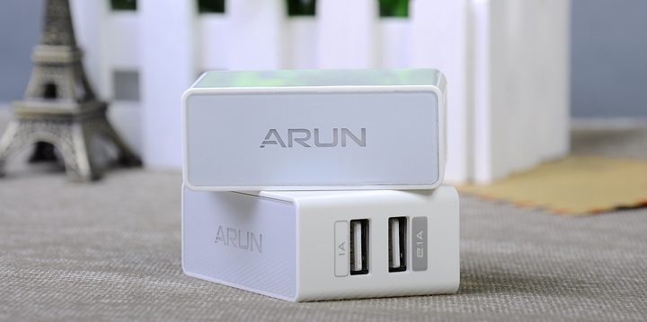
QUICK CHARGER
QUALCOMM chipset enabled
Backlit branding option

Slide 3
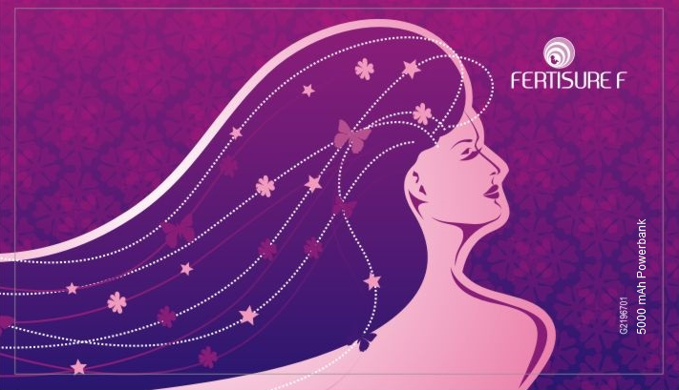
Sleek power banks
HD Quality edge to edge printing

Slide 4
PEARL FINISH POWER BANK
3900 mAh AAA quality
Lithium Polymer cells

Slide 5
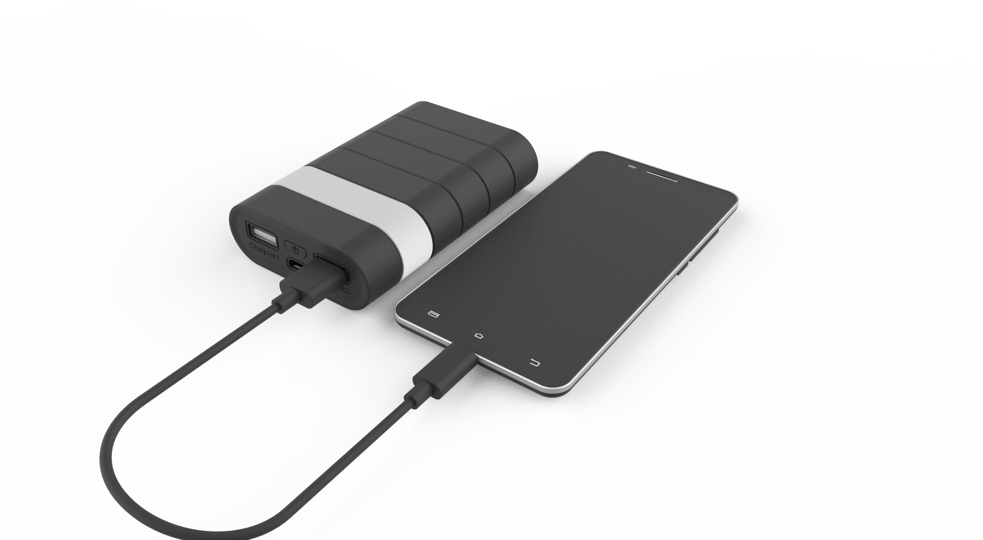
Y series power banks
Super Quick Charging
Branding option on the highlighted band

Slide 6
C207 CAR CHARGERS
2.6A charging speed

Slide 7
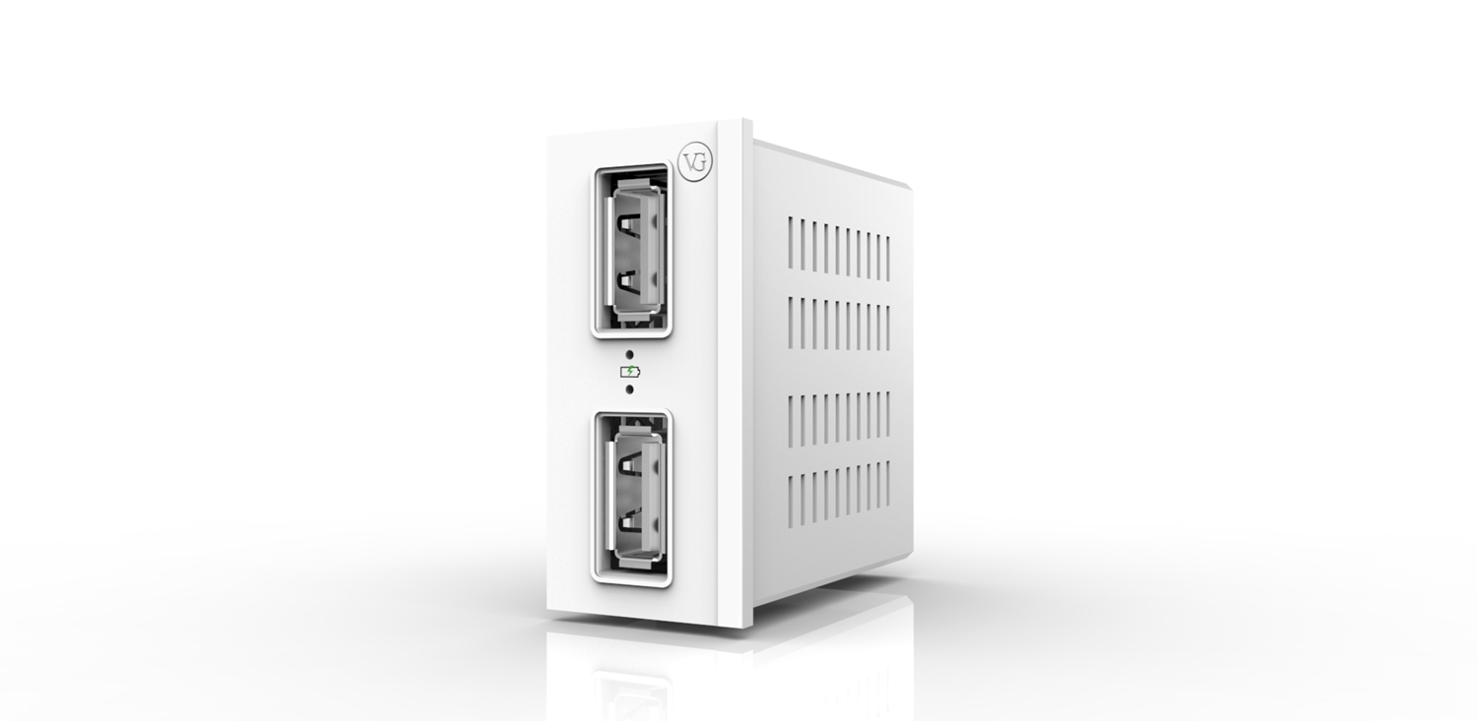
BUILT-IN SOCKET CHARGER

Slide 8
OVER 80% OF OUR CLIENTS GIVE US REPEAT ORDERS
CUSTOM OFFERINGS
BANDWIDTH TO HANDLE LARGE ORDERS
VERY COMPETITIVE

Slide 9
contact us now
MUNOTH COMMUNICATION LIMITED
MUNOTH CENTRE, 343 TRIPLICANE HIGH ROAD, CHENNAI 600 005
+91 44 2859 1190, + 91 98402 15355, ranjani@munothcommunication.com
www.vgaccessories.com, www.munothcommunication.com

